Slide 1

Unit-5 Syllabus
Memory System 2 2
RAM, ROM, EPROM, EEPROM, concepts of DRAM, SRAM, and Cache memory.

Slide 2
MEMORY COMPONENTS
Memory Components
0
Logical Organization
words
(byte, or n bytes)
N - 1
Random Access Memory
- Each word has a unique address
- Access to a word requires the same time
independent of the location of the word
- Organization
n data input lines
k address lines
Read
Write
2^{k} Words
(n bits/word)
n data output lines

Slide 3
READ ONLY MEMORY(ROM)
Memory Components
Characteristics
- Perform read operation only, write operation is not possible
- Information stored in a ROM is made permanent
during production, and cannot be changed
- Organization
k address input lines
m x n ROM
(m=2^{k})
n data output lines
Information on the data output line depends only
on the information on the address input lines.
--> Combinational Logic Circuit
address Output
ABC X₀ X₁ X₂ X₃ X₄
X₀=A’B’ + B’C
X₁=A’B’C + A’BC’
X₂=BC + AB’C’
X₃=A’BC’ + AB’
X₄=AB
X₀=A’B’C’ + A’B’C + AB’C
X₁=A’B’C + A’BC’
X₂=A’BC + AB’C’ + ABC
X₃=A’BC’ + AB’C’ + AB’C
X₄=ABC’ + ABC
000
001
010
011
100
101
110
111
1 0 0 0 0
1 1 0 0 0
0 1 0 1 0
0 0 1 0 0
0 0 1 1 0
1 0 0 1 0
0 0 0 0 1
0 0 1 0 1
Canonical minterms

Slide 4
TYPES OF ROM
Memory Components
ROM
- Store information (function) during production
- Mask is used in the production process
- Unalterable
- Low cost for large quantity production --> used in the final products
PROM (Programmable ROM)
- Store info electrically using PROM programmer at the user’s site
- Unalterable
- Higher cost than ROM -> used in the system development phase
-> Can be used in small quantity system
EPROM (Erasable PROM)
- Store info electrically using PROM programmer at the user’s site
- Stored info is erasable (alterable) using UV light (electrically in
some devices) and rewriteable
- Higher cost than PROM but reusable --> used in the system
development phase. Not used in the system production
due to eras ability

Slide 5
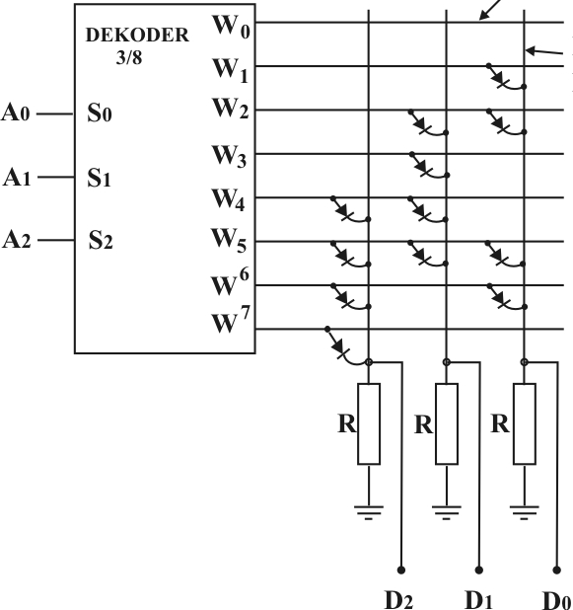
Mask ROM
The “simplest” memory technology
Presence/absence of diode at each cell denote value
Pattern of diodes defined by mask used in fab process
Contents are fixed when chip is made; cannot be changed
High upfront setup costs (mask costs)
Small recurring marginal costs
Good for applications where
Cost sensitivity drives design
Upgrading contents not an issue
e.g. boot ROM, CPU microcode
Exercise:
What “value” does a diode encode?
What are the contents:
Where A<2:0> = 101?
Where A<2:0> = 110?
word
lines
Bit
lines

Slide 6
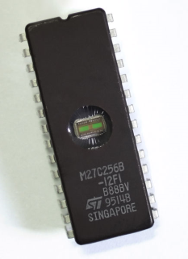
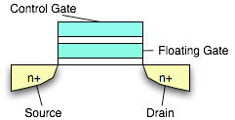

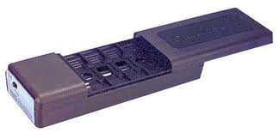
EPROM
Erasable Programmable Read-Only Memory
Constructed from floating gate FETs
Charge trapped on the FG erases cell
High voltage (13V +) applied to the control gate
“Writes” the cell with a 0
Allows FG charge to be dissipated
Erasing means changing form 0 → 1
Uses UV light (not electrically!)
Electrons are trapped on a floating gate
Writing means changing from 1 → 0
Erase unit is the whole device
Retains data for 10-20 years
Not used much these days
Costly because
Use of quartz window (UV transparent)
Use of ceramic package
PROM (or OTP) is same, just w/o window

Slide 7
Flash Memory
Electrically erasable (like EEPROM, unlike EPROM)
Used in many reprogrammable systems these days
Erase size is block (not word); can’t do byte modifications
Erase circuitry moved out of cells to periphery
Smaller size
Better density
Lower cost
Reads are like standard RAM
Can “write” bits/words (actually, change from 1 → 0)
Write cycle is O(microseconds)
Slower then RAM but faster than EEPROM
To (re)write from 0 → 1, must explicitly erase entire block
Erase is time consuming O(milliseconds to seconds)
Floating gate technology
Erase/write cycles are limited (10K to 100K, typically)

Slide 8
Static RAM (SRAM) and Dynamic RAM (DRAM)
Feature | Static RAM (SRAM) | Dynamic RAM (DRAM)
Full form | Static Random Access Memory | Dynamic Random Access Memory
Storage principle | Uses flip-flops (latches) | Uses capacitors
Data refresh | Not required | Required periodically (refresh needed)
Speed | Very fast | Slower compared to SRAM
Complexity | More complex circuitry | Simpler circuitry
Cost | Expensive | Cheaper
Power consumption | Higher (per bit) but no refresh power | Lower per bit but needs refresh power
Density (storage capacity) | Low density | High density
Chip size | Larger | Smaller
Typical use | Cache memory (L1, L2, L3) | Main memory (RAM in computers)
Data retention | Holds data as long as power is ON | Loses data quickly without refresh

Slide 9
Cache Memory
Cache Memory
Cache memory is a small, very high-speed memory located near the CPU.
It stores frequently used data and instructions to reduce access time to RAM.
It improves CPU performance by reducing waiting time.
Working:
CPU first checks cache memory
Cache Hit → Data found (fast access)
Cache Miss → Data fetched from RAM
Levels:
L1 Cache → Fastest, smallest (inside CPU core)
L2 Cache → Medium speed and size
L3 Cache → Largest, shared cache
Memory Hierarchy:
CPU → Cache → RAM → Storage

Slide 10
